Slide 1
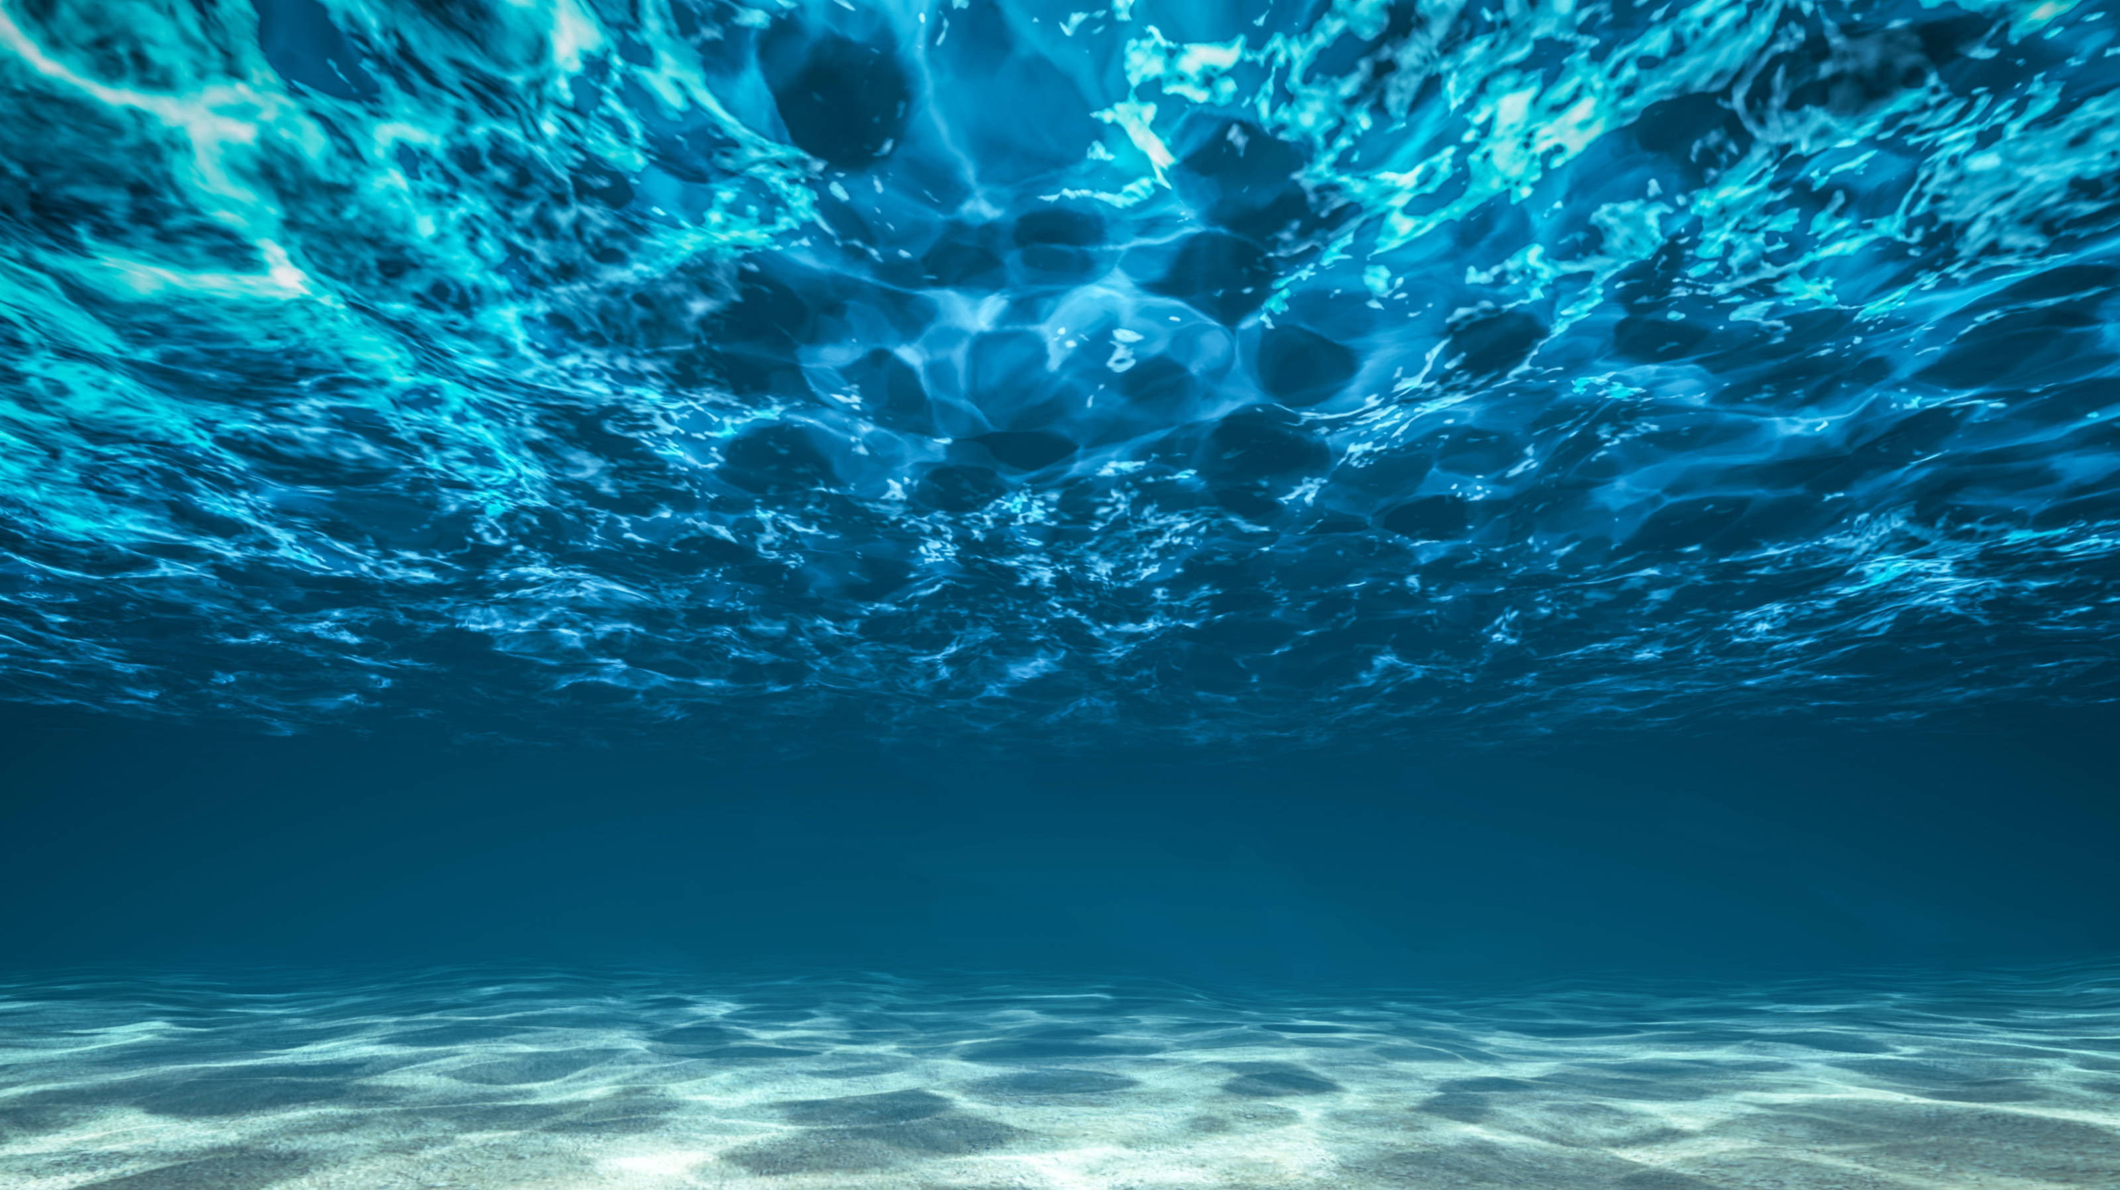
Testbed for underwater communication
Felipe Bahamondes, Mathias Markvardsen, Morten Henriksen

Slide 2

Guess a message!
Answer: ”Hello_there”

Slide 3
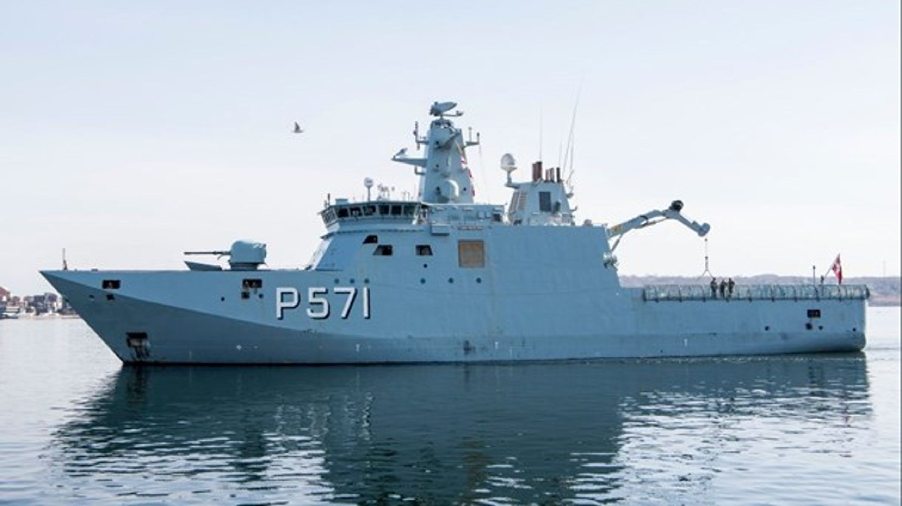
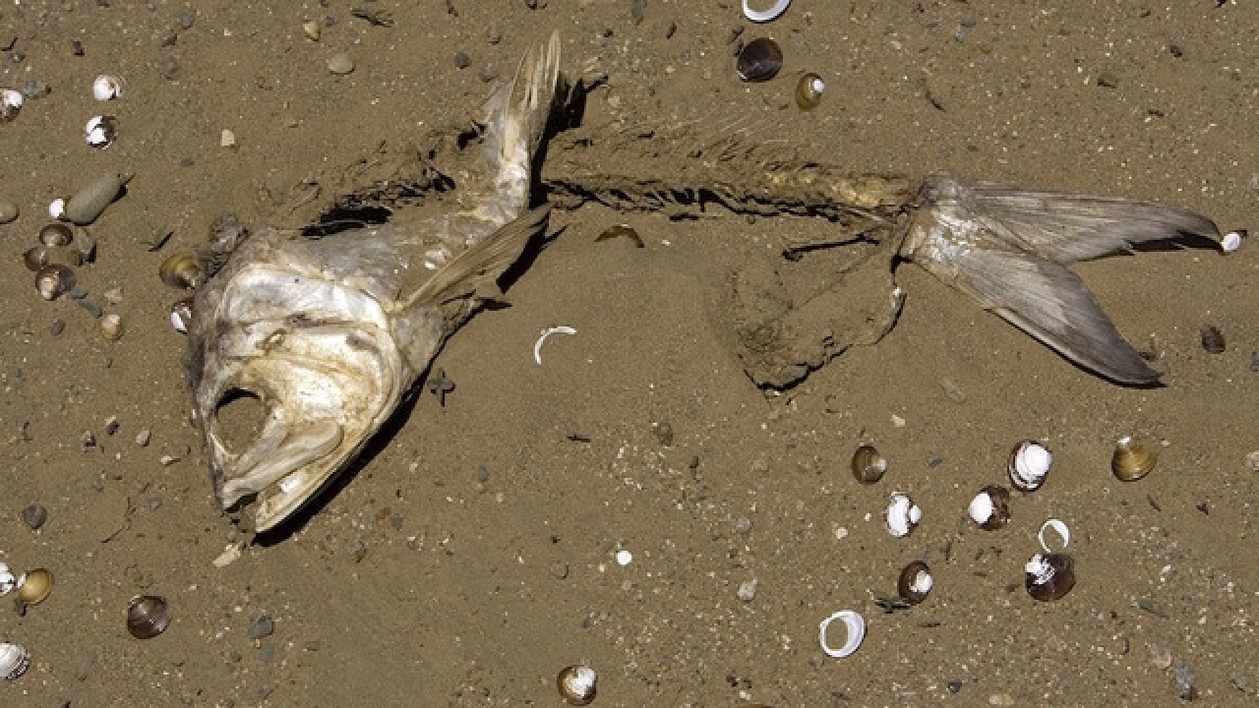
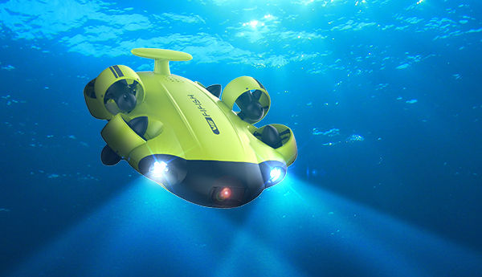
Project Details
Bachelor project
“The aim of this project is to design and implement a basic underwater communication system that can transmit data from an underwater speaker to a hydrophone receiver…”
A lot of freedom to choose
No prior knowledge
3 software students, who liked math and programming

Slide 4
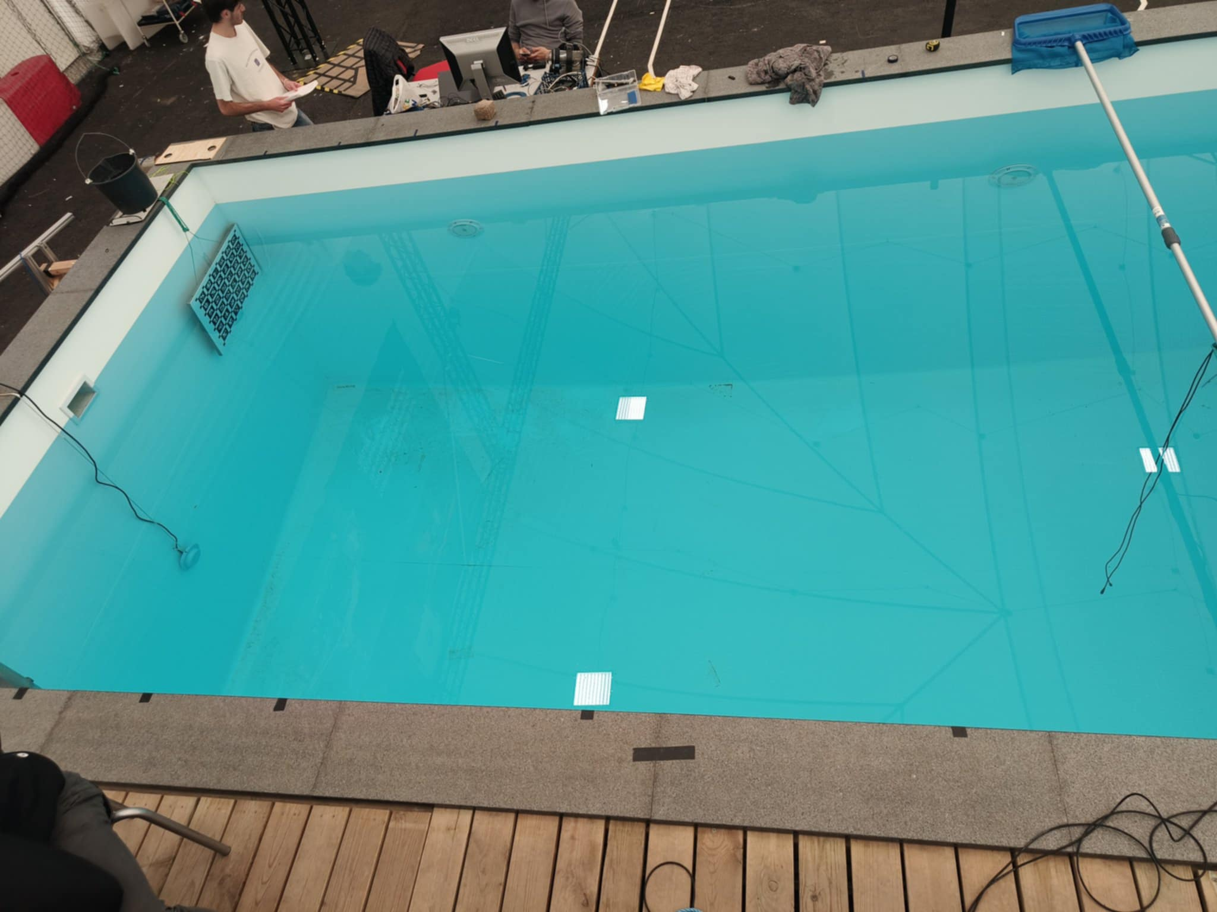
The Pool
Speaker
Hydrophone
2 m
5 meters

Slide 5
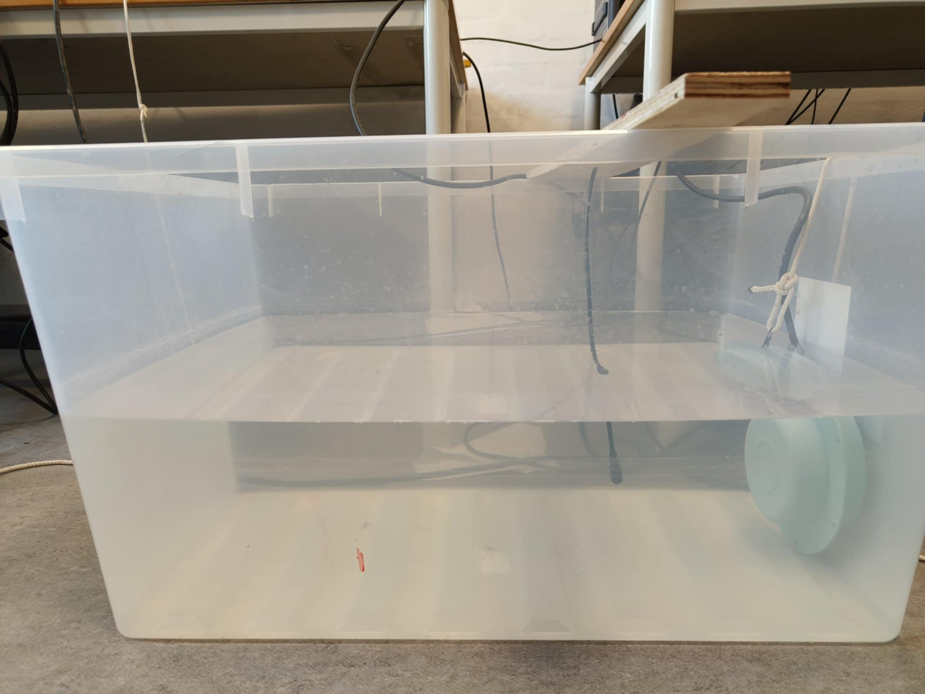
The Plastic Tank
Speaker
Hydrophone

Slide 6
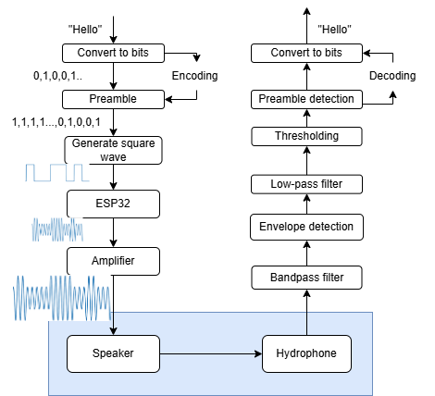
Protocol

Slide 7
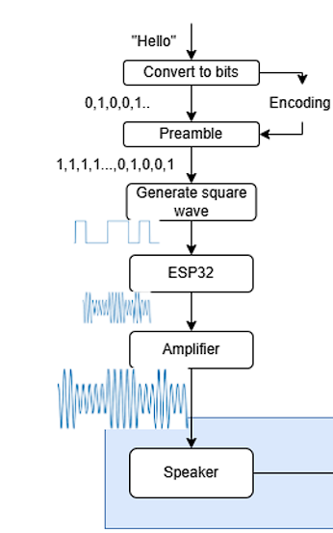
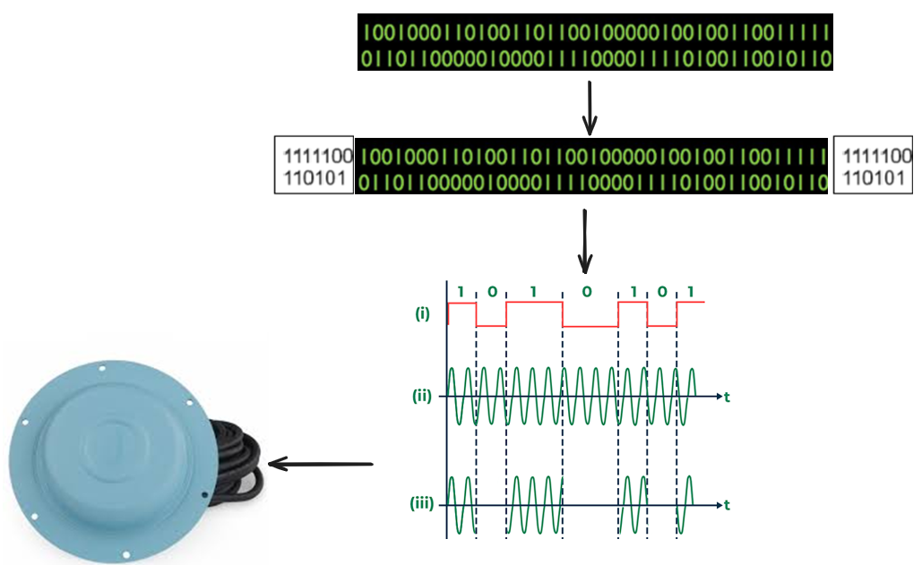
Transmitter

Slide 8
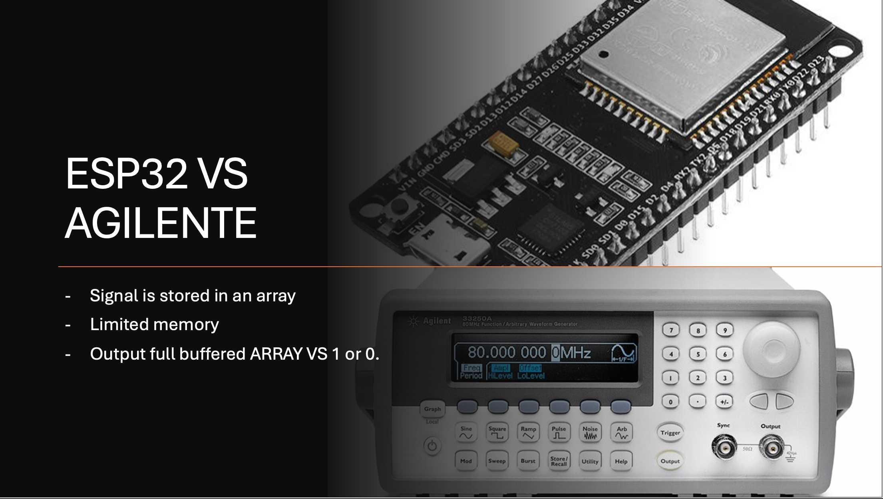

Slide 9
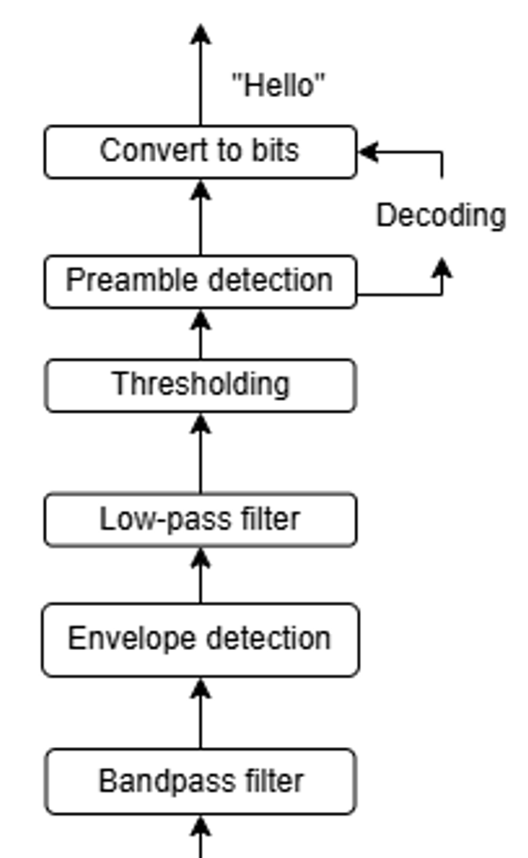

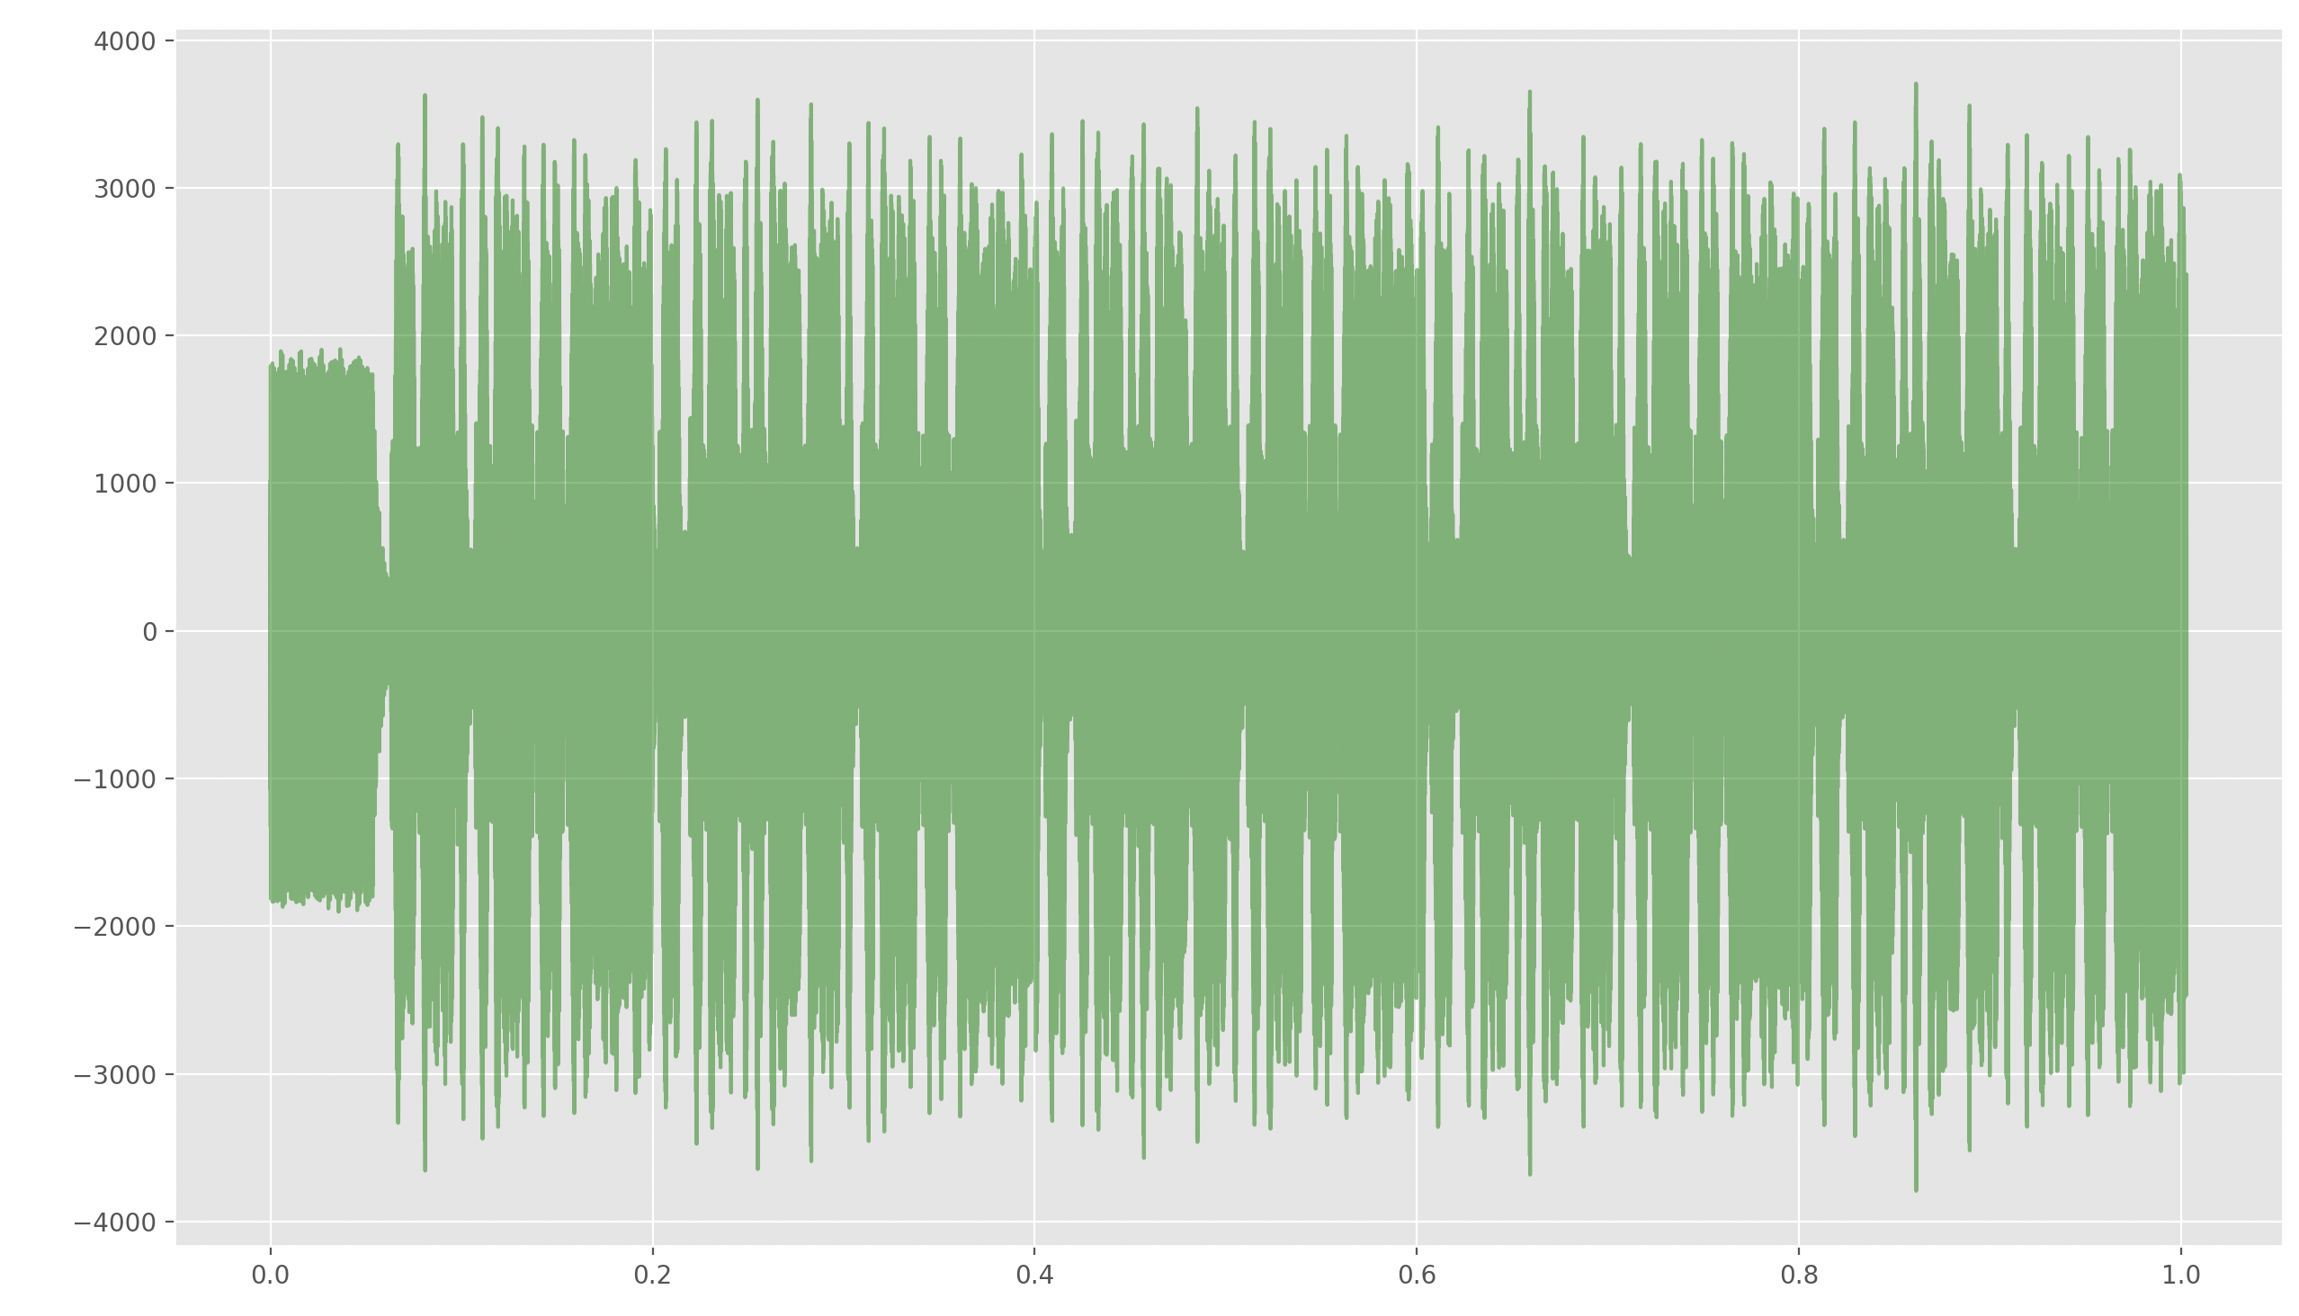
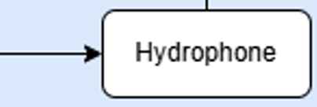
Receiver
The hydrophone is constantly monitoring pressure differences in the water (acoustic signals)
→ Converts to electricity
→ Computer RECORDS a wav file
Digital Signal Processing is fun!
Computer

Slide 10
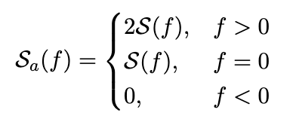
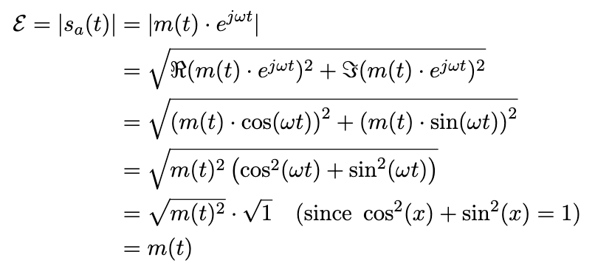
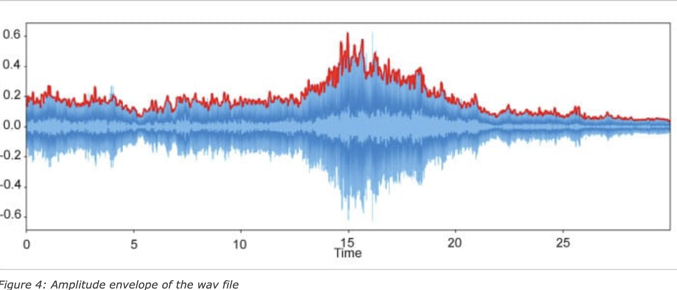
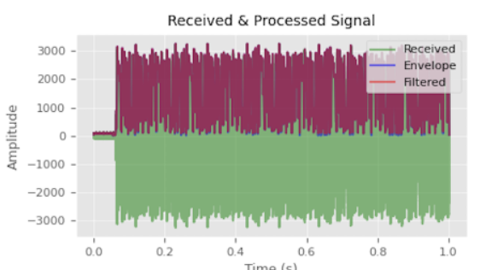
Analytic Signal, Envelope and Fourier Transformations!
Quick Maths that gets rid of the carrier frequency for an Amplitude modulated signal

Slide 11
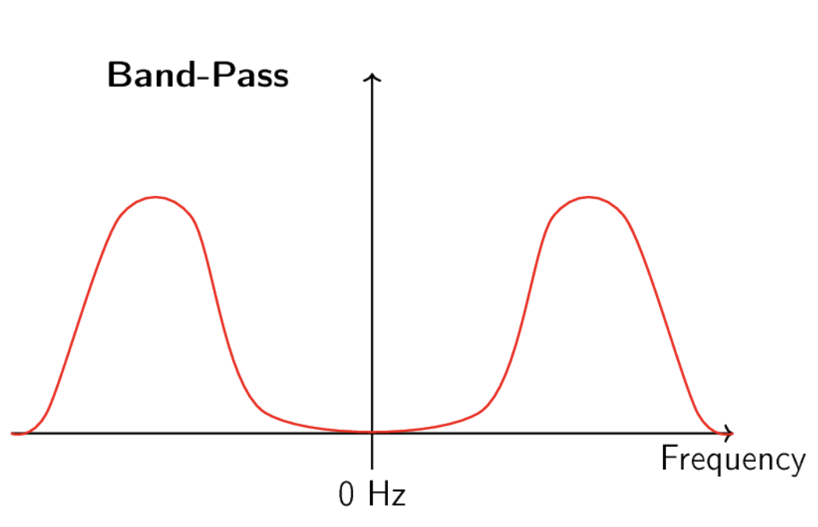
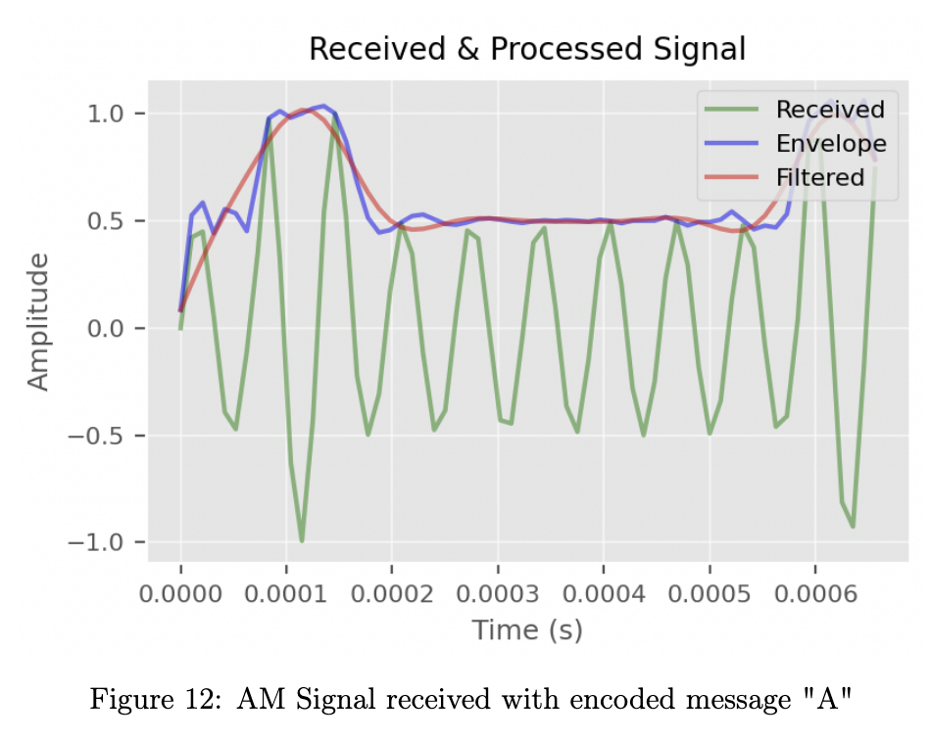
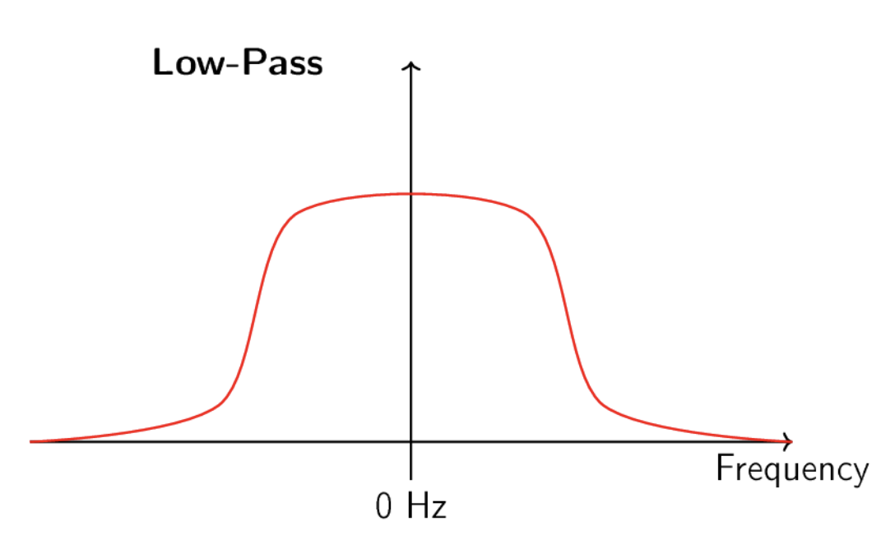
What about noise?
Ref and acknowledgements : pySDR; https://pysdr.org/content/intro.html

Slide 12
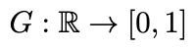
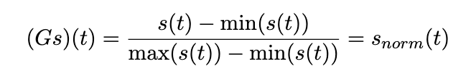
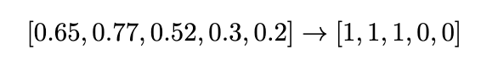
How do we threshold?
min-max normalization
2. check: x < 0.5

Slide 13
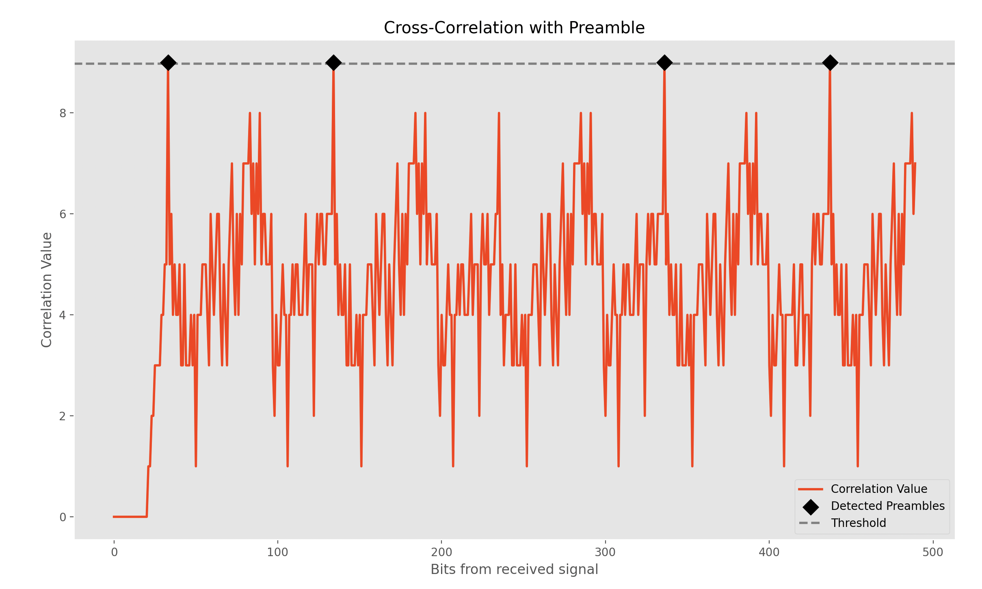
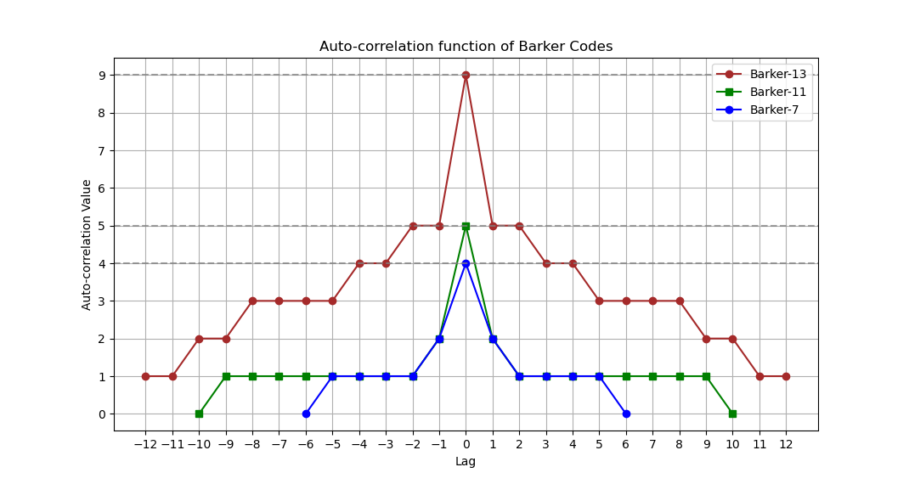
How do we find the actual message?
Barker 13 preamble
[1,1,1,1,1,0,0,1,1,0,1,0,1]
“Hello_there”
Bit rate : 500
Carrier Frequency : 6000kHz

Slide 14


Slide 15
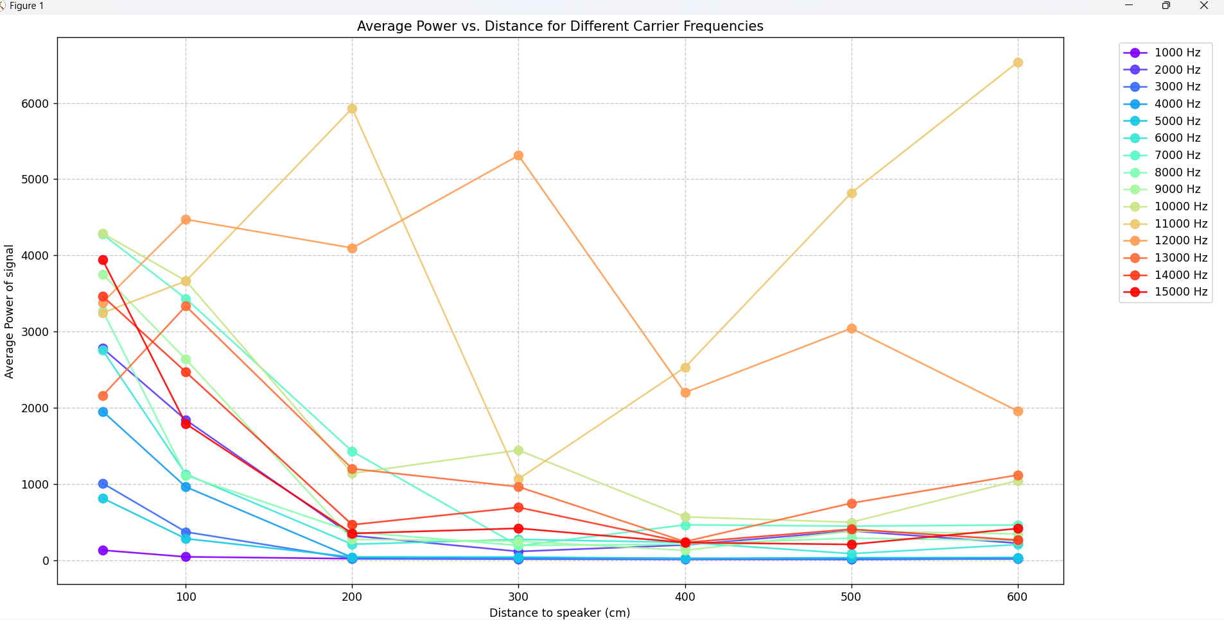
INTERFERENS
Interference and Attenuation

Slide 16
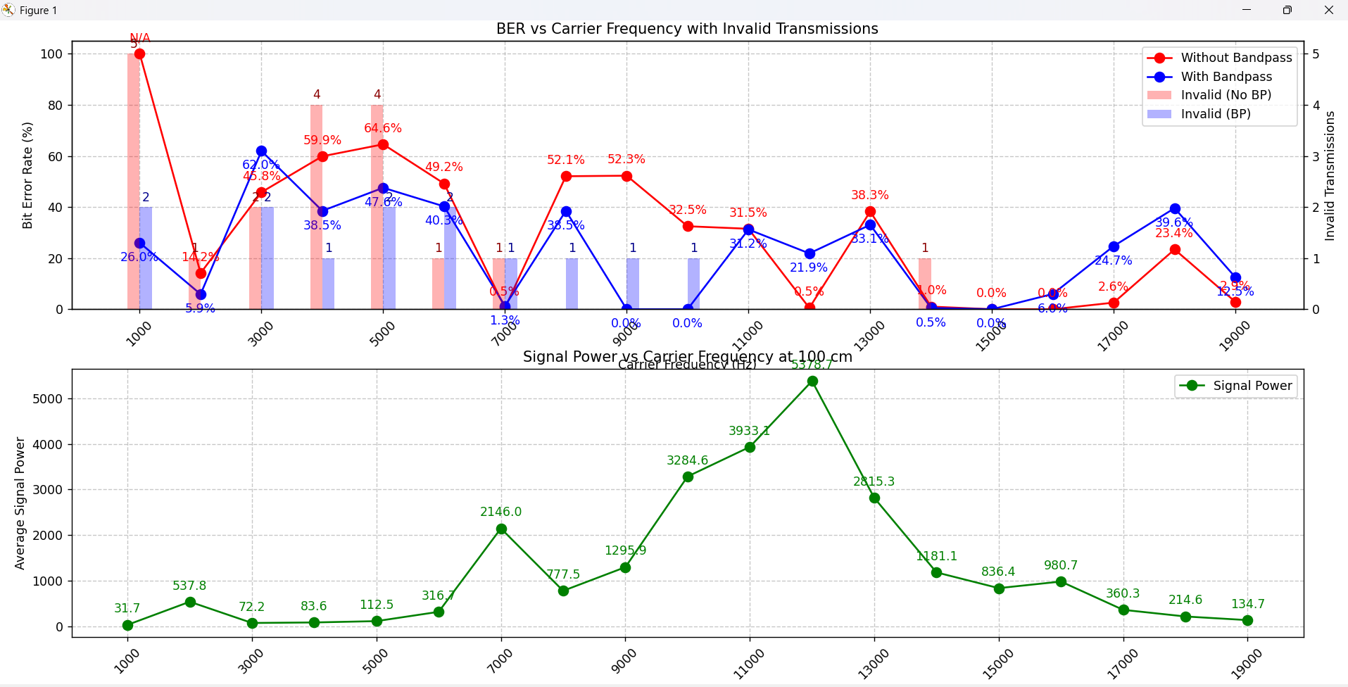
Strong signal = good signal ?

Slide 17
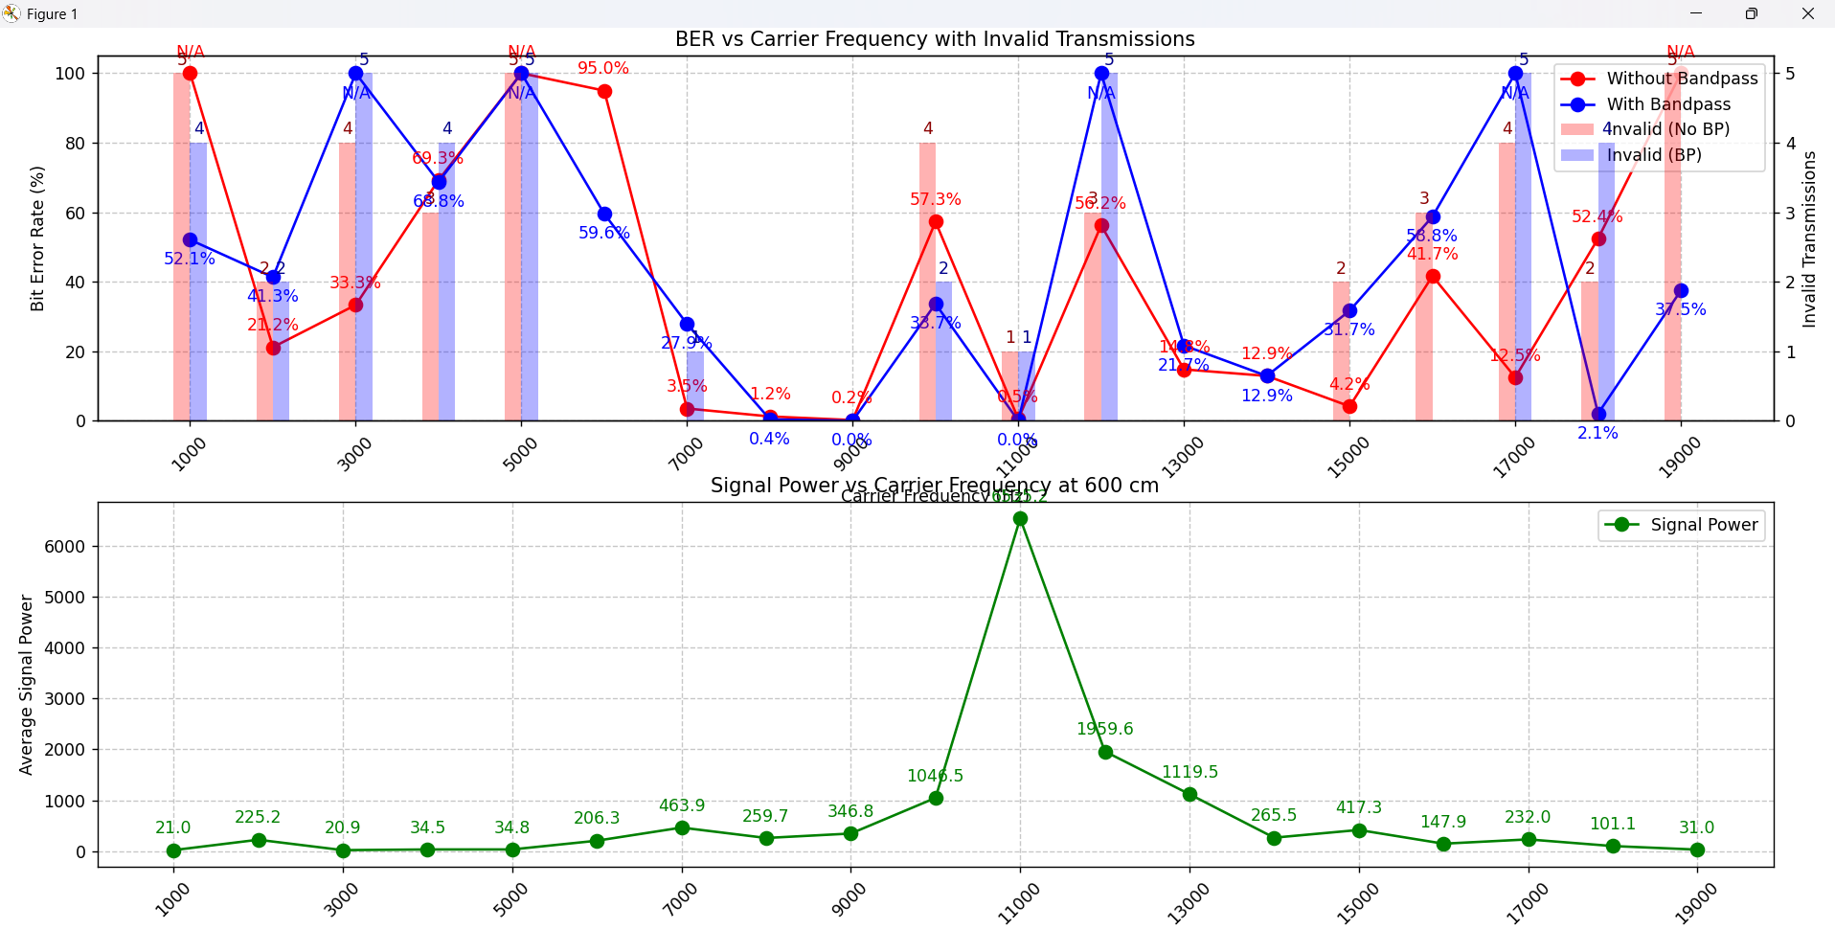
Is 15000 Hz still the goat?

Slide 18
PPC (Preamble Payload Correlation)
unique_payloads_dict = {
"2" : "]3MH'@@H9&e6W",
"3" : '}VvF*E@9>-go*',
"4" : '+,M4J1ABraRJ&',
"5" : 'i3aw,*X@j&y;y',
"6" : '~7,w]@s,V+{2Y',
"7" : ']_TzaWWF+Exg;',
"8" : 'Oi67/(~V8]w,x',
"9" : 'N(#-c~nC(^v>A'
}

Slide 19
Max bitrate at different distances
Payload composition
Payload size

Slide 20

Problems
ESP
Speaker

Slide 21
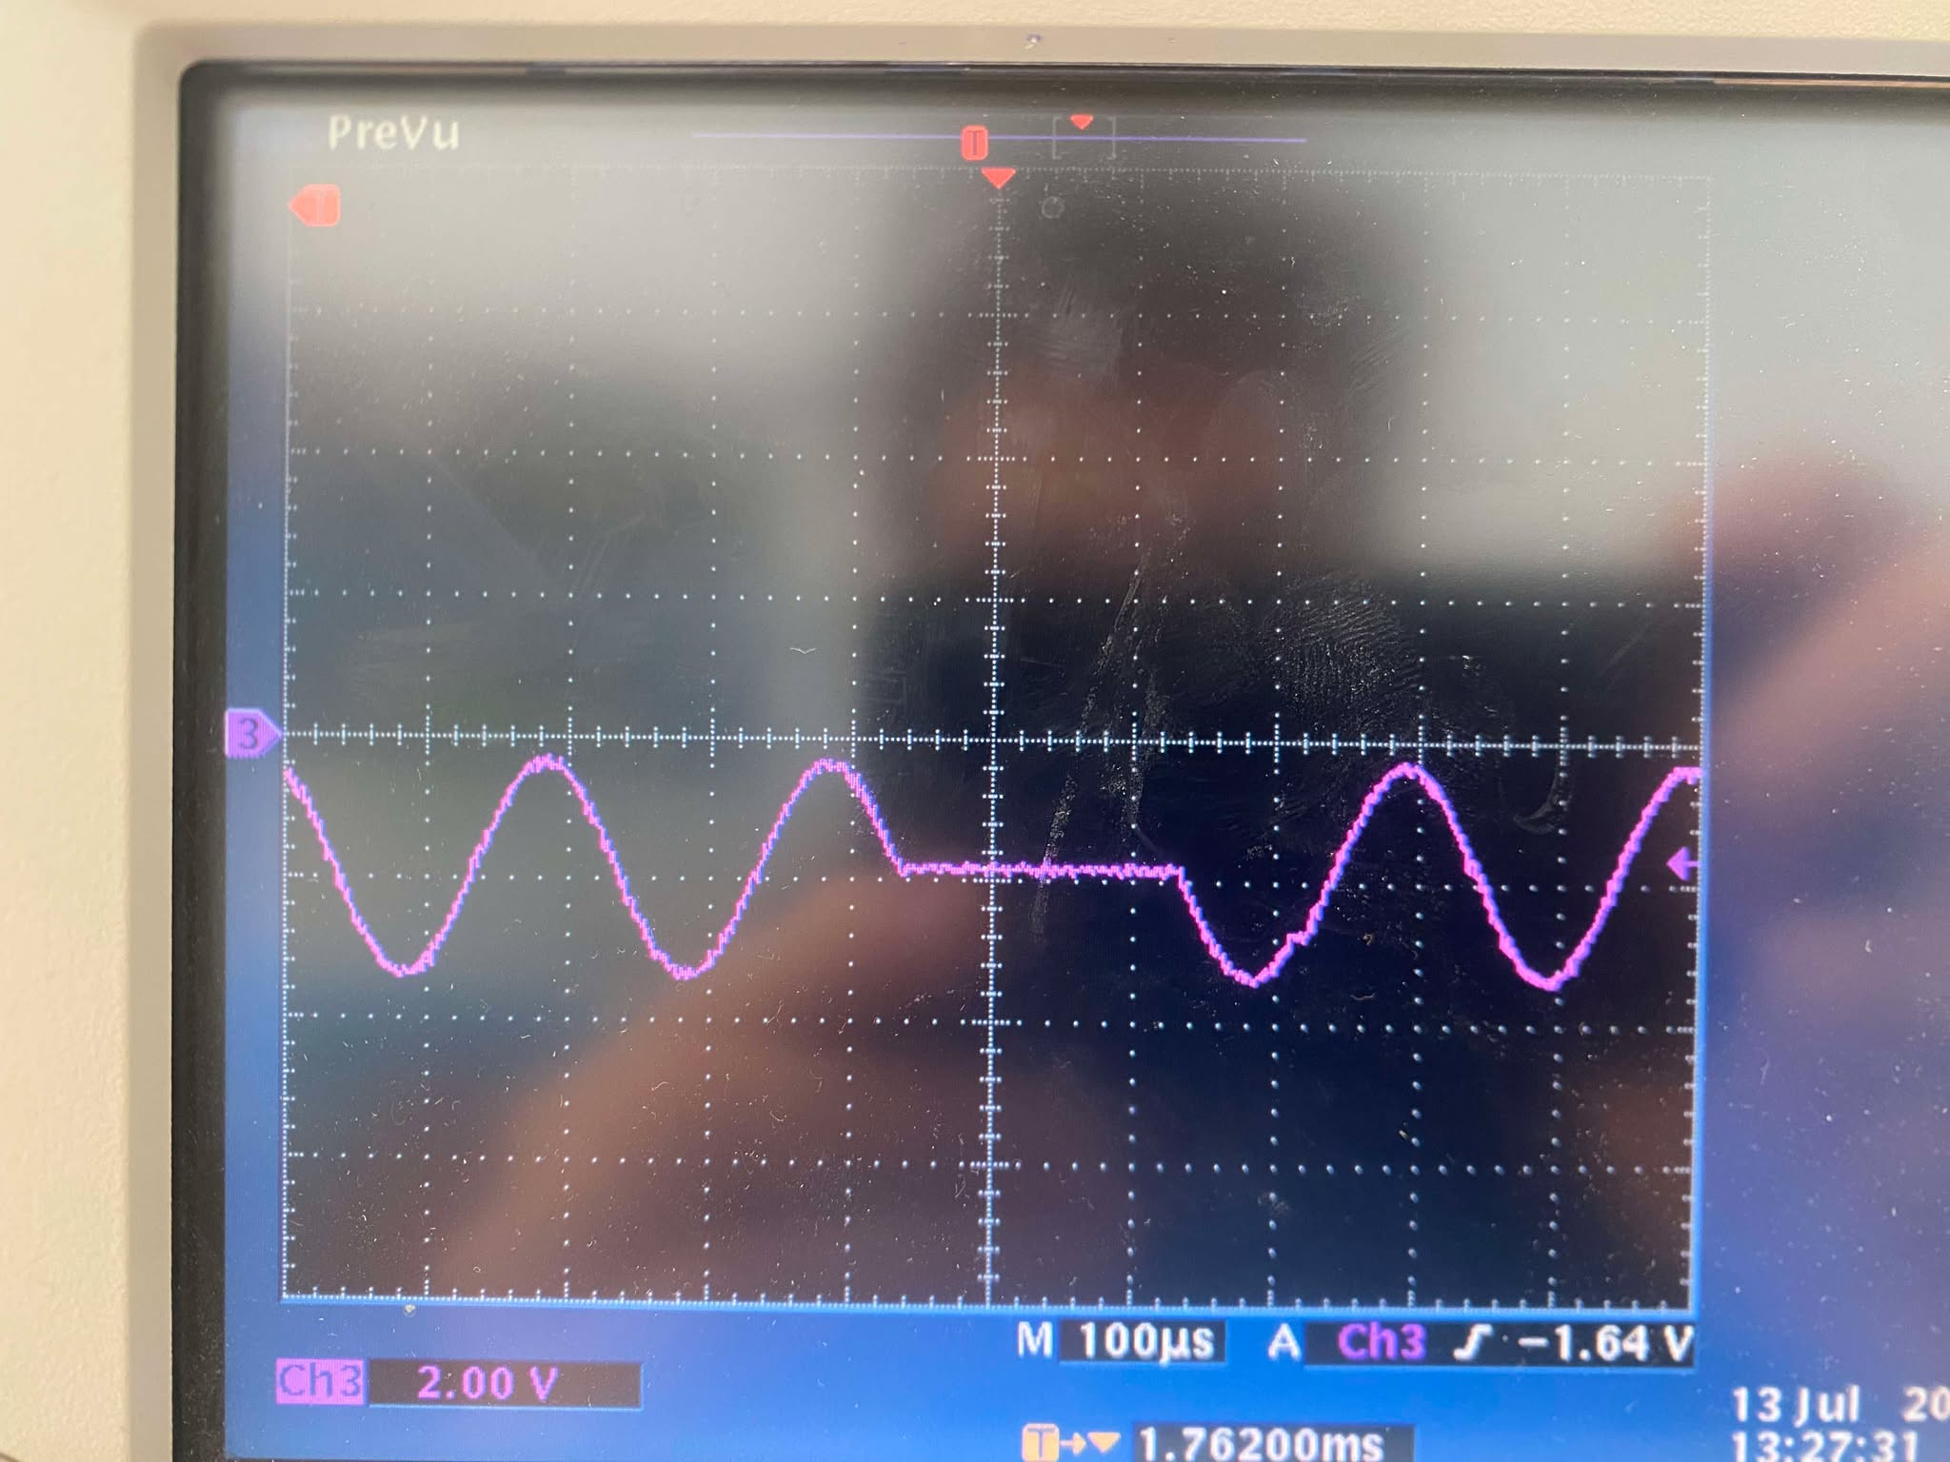
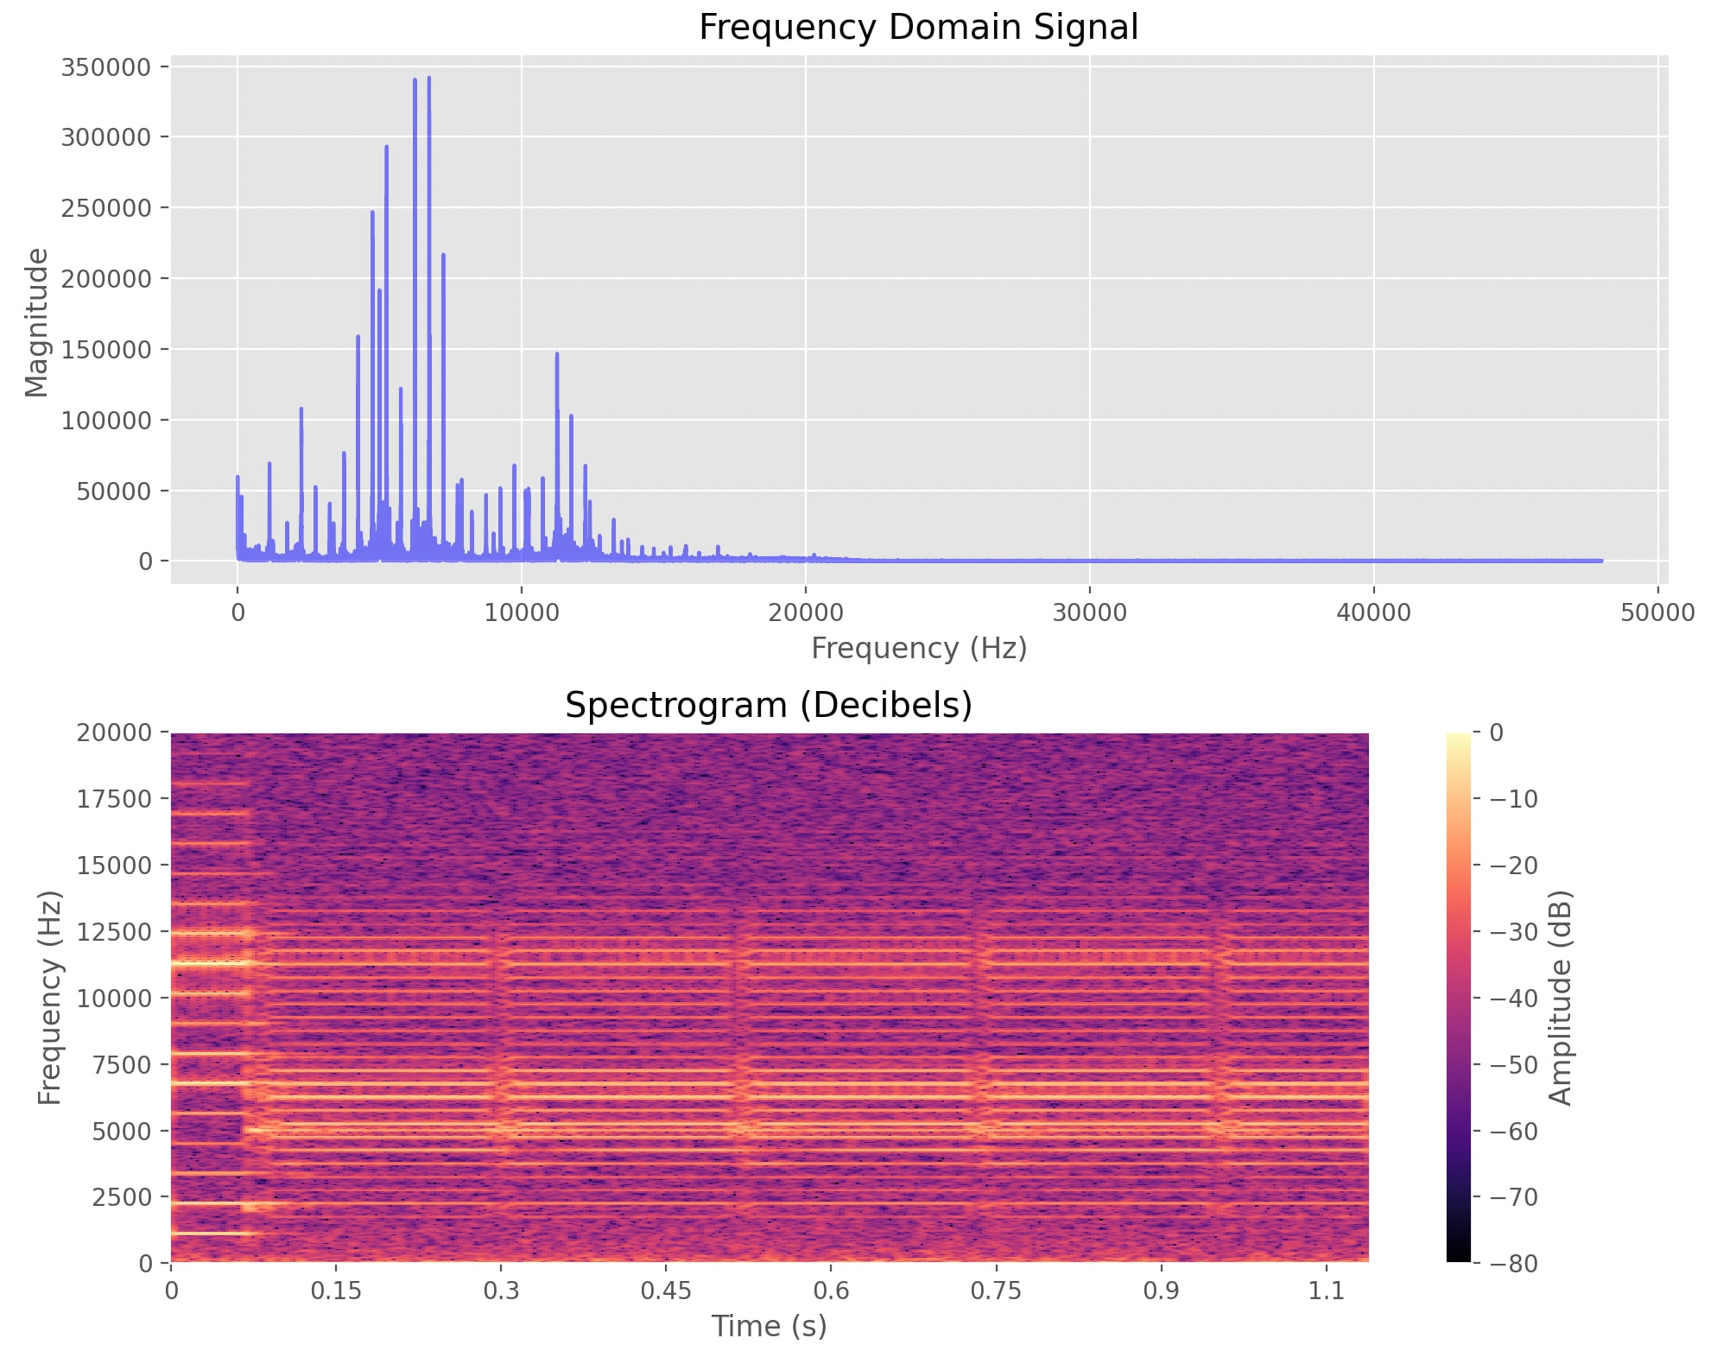
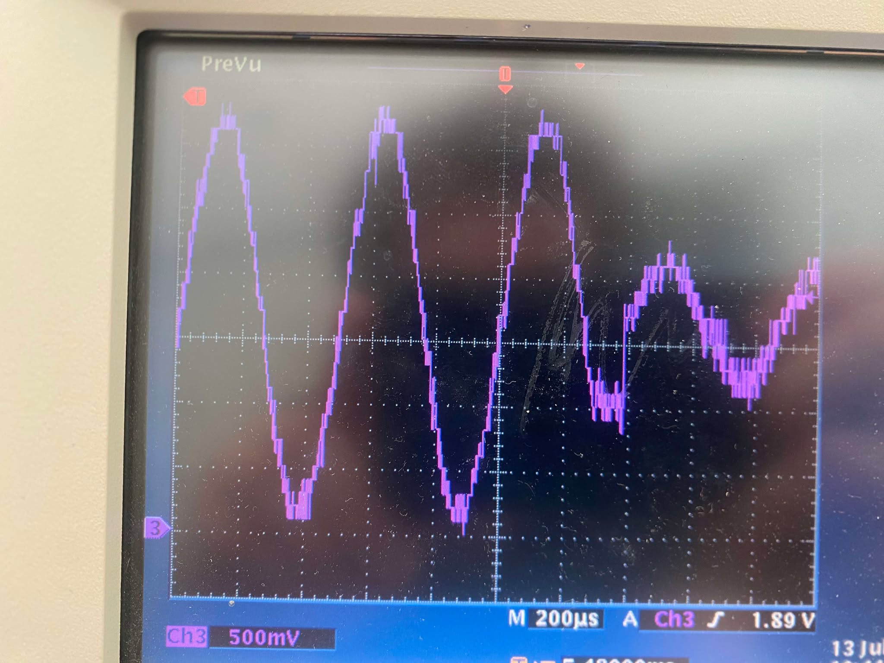
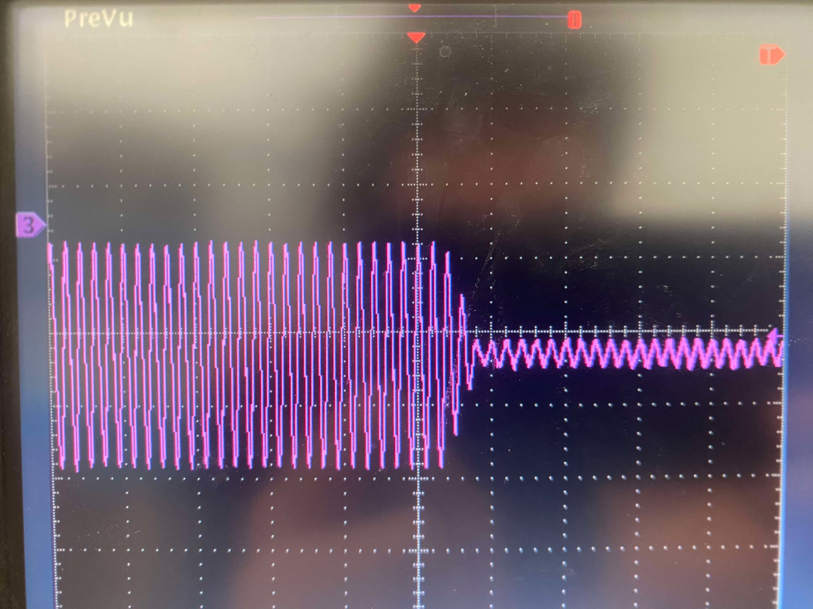
ESP

Slide 22
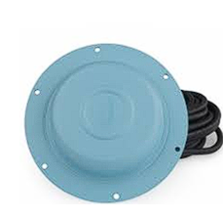
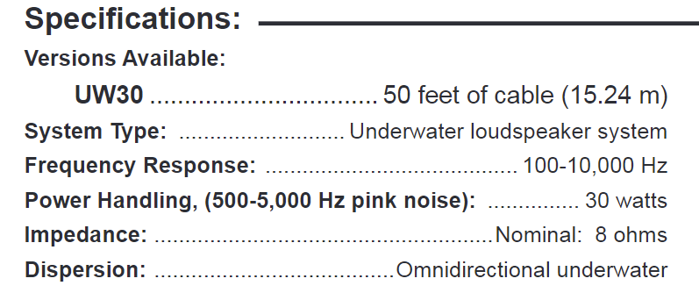
Speaker
Starts to behave weird when we exceed this value

Slide 23
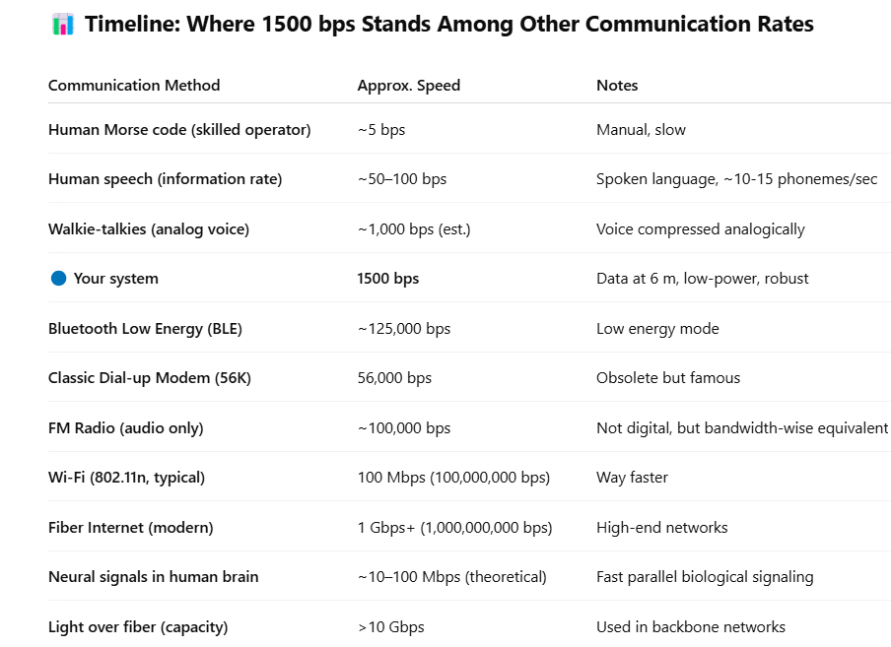

Slide 24
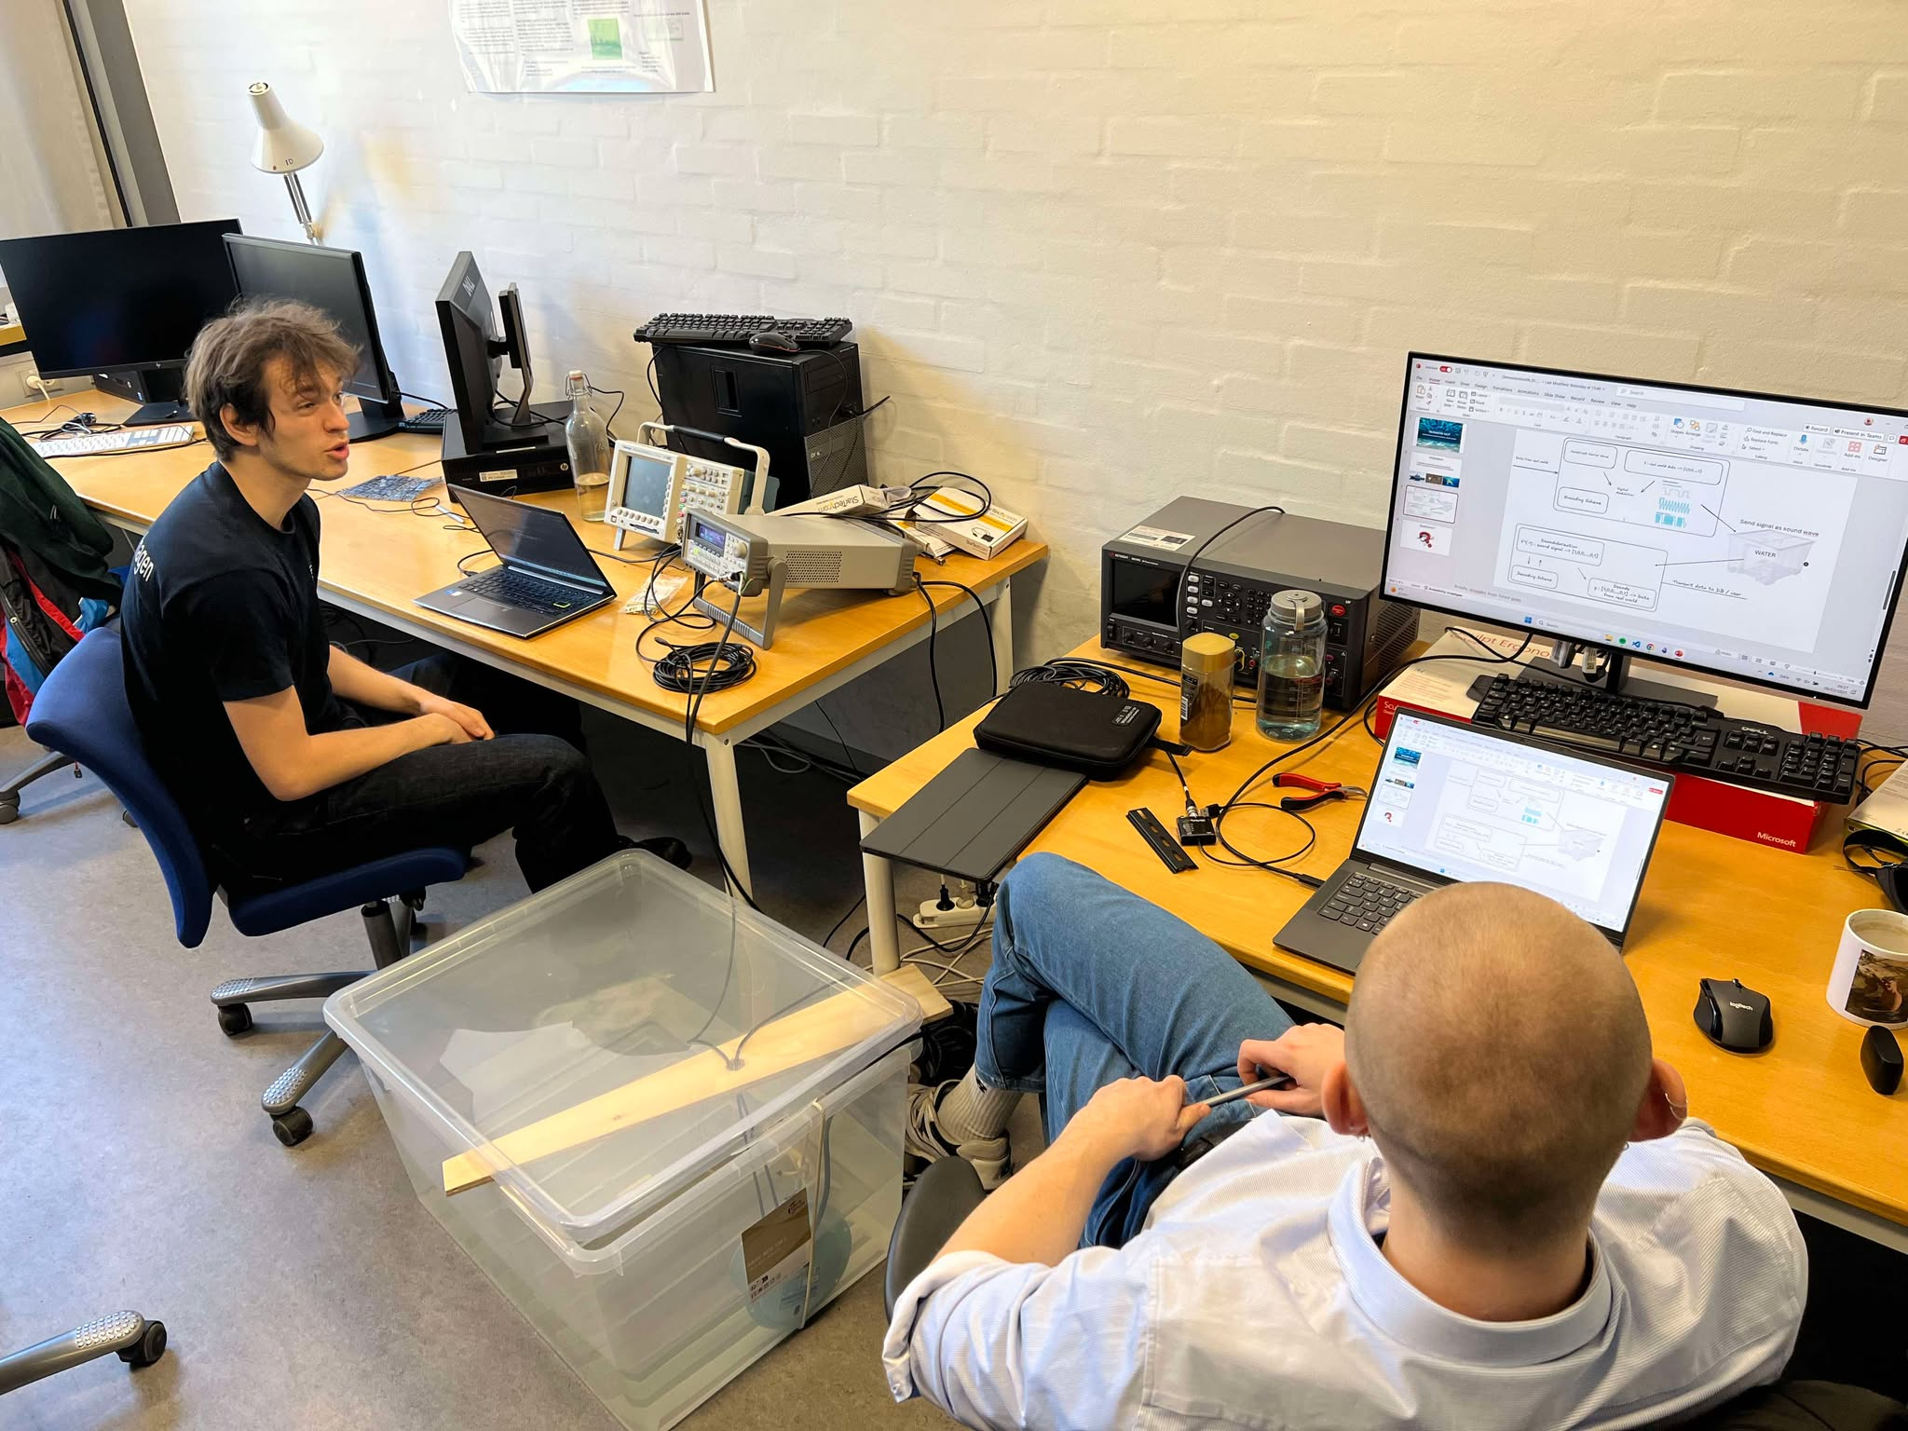

Questions?

Slide 25
Appendix

Slide 26
